Slide 1



PC Parts
Team - 25
Divesh Naidu, Srikar Veldandi, Yanda Yuan

Slide 2
Agenda
z
Purpose
ERD & DDL
Functions and Triggers
Views & Visualizations
Q & A

Slide 3
Our Purpose
Mission
Business use cases
Make the convoluted world of PC parts more accessible.
Help both customers and employees.
Identify valuable customers and locations for marketing
Analytical data for making business decisions
Boost day-to-day functions such as keeping track of stock

Slide 4
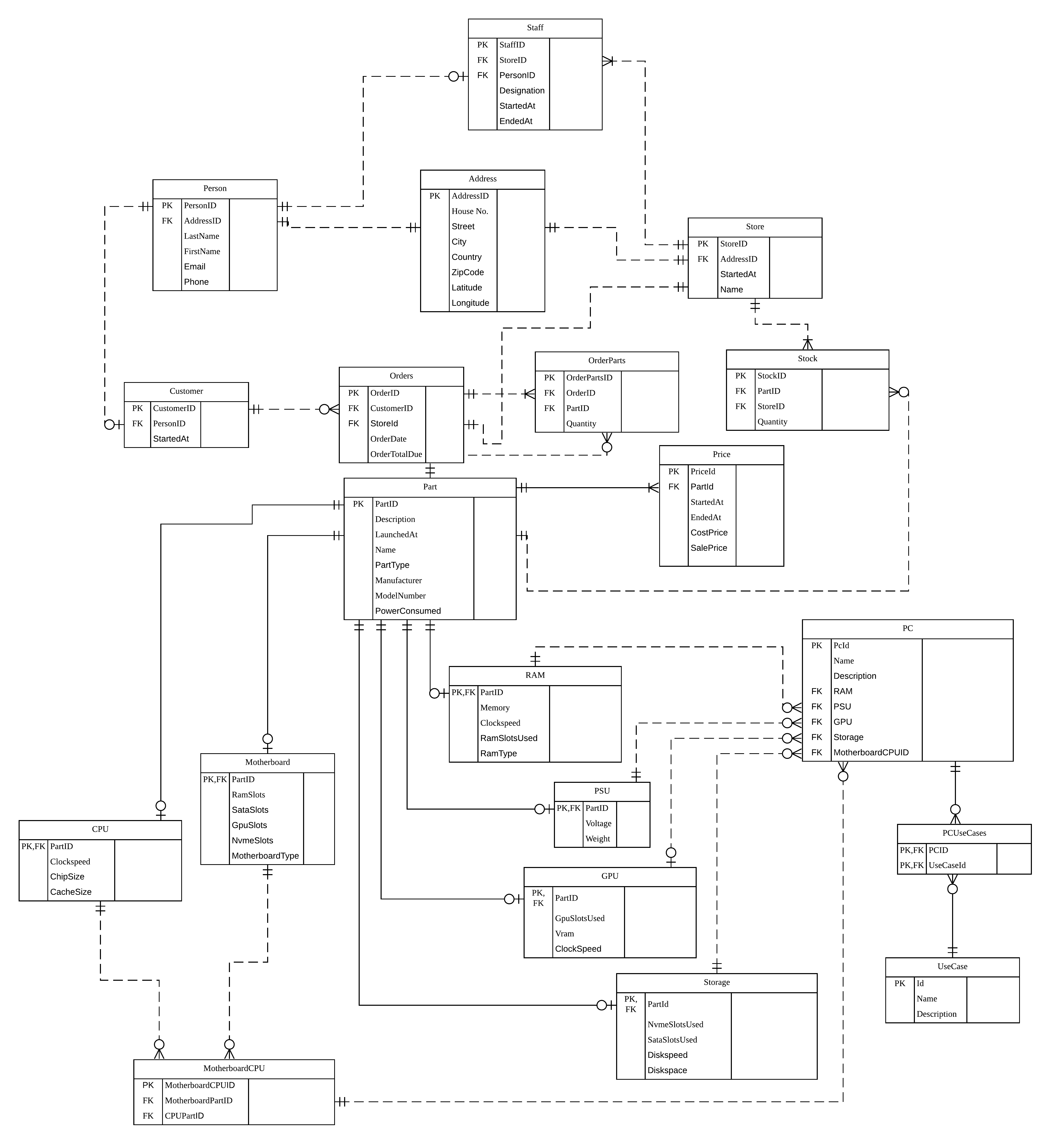
ERD
Link to full size image

Slide 5
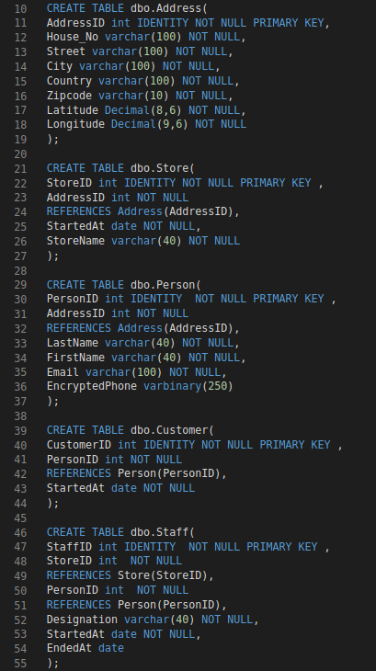
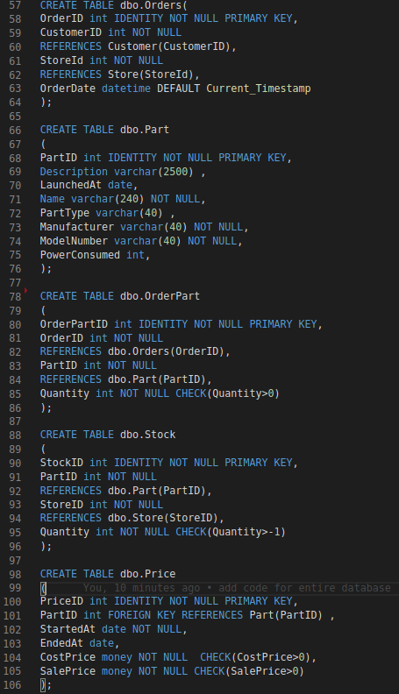
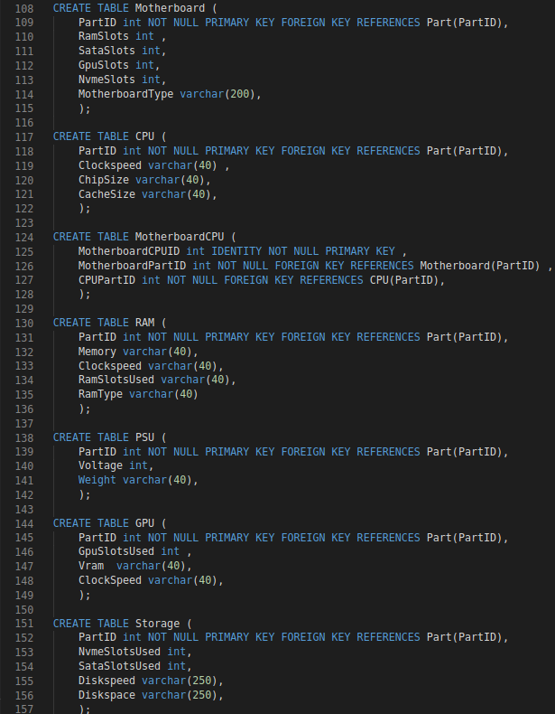
DDL

Slide 6
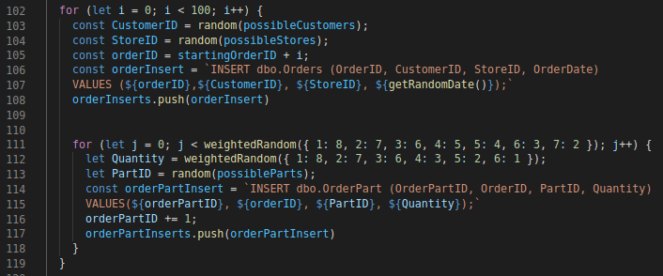
Inserting Data
Data sources
Got PC part data from Amazon store pages.
Customers are named after characters from TV shows.
Order data was generated using JavaScript to output weighted random data.

Slide 7
Functions and Triggers
Triggers
Functions
check_date_staff
check_date_price
check_PartType_RAM
check_PartType_GPU
check_PartType_PSU
check_PartType_Storage
check_PartType_Motherboard
check_PartType_CPU
orderPart_check_stock
CheckPower
CheckSlots
GetOrderTotal

Slide 8
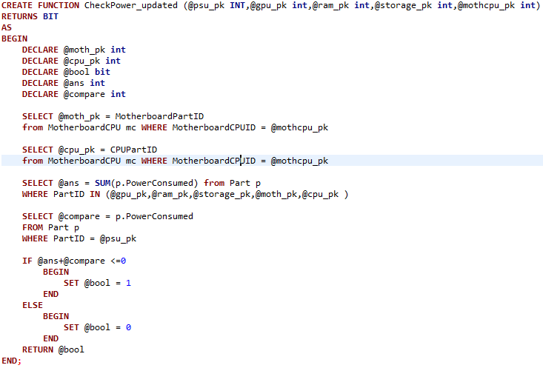
Function--CheckPower
CHECK (dbo.CheckPower_updated(PSU ,GPU ,RAM ,Storage ,MotherboardCPU )=1);

Slide 9
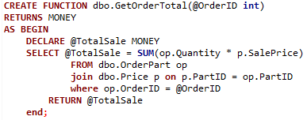
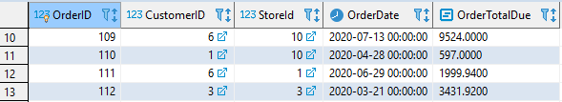
Computed column
Function
ALTER TABLE Orders
ADD OrderTotalDue AS (dbo.GetOrderTotal(OrderID));

Slide 10
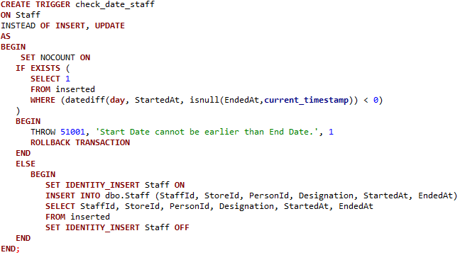
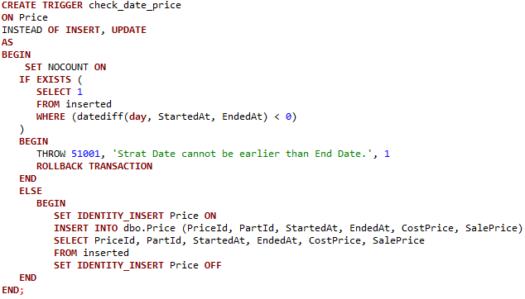
Triggers
check_date_staff
check_date_price

Slide 11
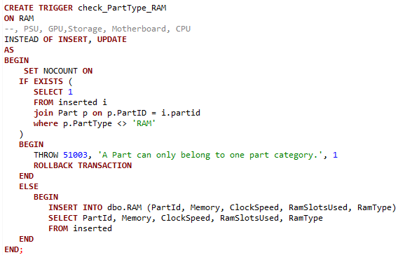
check_PartType_Triggers
Ram

Slide 12
CREATE TRIGGER orderPart_check_stock
ON OrderPart
Instead OF INSERT, UPDATE, DELETE
AS
BEGIN
SET NOCOUNT ON
-- Insert Case
--orderpart quantity < 1
IF EXISTS( SELECT * FROM inserted) AND NOT EXISTS (SELECT * FROM deleted) AND
EXISTS (
SELECT 1
FROM inserted
WHERE (quantity < 1)
)
BEGIN
THROW 51002, 'Part quantity cannot be less than 1.', 1
ROLLBACK TRANSACTION
END
-- stock is not enough
IF EXISTS( SELECT * FROM inserted) AND NOT EXISTS (SELECT * FROM deleted) AND
EXISTS (SELECT stocktemp.quantity-i.quantity From Inserted i
join (select s.quantity, s.PartID, s.StoreID,o.OrderID from stock s
join orders o on o.StoreId = s.StoreID) AS stocktemp
on stocktemp.partid = i.partid and stocktemp.orderID = i.orderID
where stocktemp.quantity-i.quantity < 0)
BEGIN
THROW 51004, 'Order quanity cannot greater than store stock.', 1
ROLLBACK TRANSACTION
END
-- insert orderpart
IF EXISTS( SELECT * FROM inserted) AND NOT EXISTS (SELECT * FROM deleted) AND
EXISTS (SELECT stocktemp.quantity-i.quantity From Inserted i
join (select s.quantity, s.PartID, s.StoreID,o.OrderID from stock s
join orders o on o.StoreId = s.StoreID) AS stocktemp
on stocktemp.partid = i.partid and stocktemp.orderID = i.orderID
where stocktemp.quantity-i.quantity >= 0)
BEGIN
--updated stock
UPDATE stock
SET quantity = s.Quantity - i.Quantity
FROM
Stock s
INNER JOIN INSERTED i ON i.PartID = s.PartID
join orders o on i.orderid = o.OrderID
where i.partid = s.partid and s.StoreID = o.storeID
--insert orderpart
SET IDENTITY_INSERT OrderPart ON
INSERT INTO dbo.OrderPart (OrderPartId, OrderId, PartId, Quantity)
SELECT OrderPartId, OrderId, PartId, Quantity
FROM inserted
SET IDENTITY_INSERT OrderPart OFF
END
-- Update Case
--update quantity < 1
IF EXISTS( SELECT * FROM inserted) AND EXISTS (SELECT * FROM deleted) AND
EXISTS (
SELECT 1
FROM inserted
WHERE (quantity < 1)
)
BEGIN
THROW 51002, 'Part quantity cannot be less than 1.', 1
ROLLBACK TRANSACTION
END
-- stock not enough for update
IF EXISTS( SELECT * FROM inserted) AND EXISTS (SELECT * FROM deleted) AND
EXISTS (SELECT stocktemp.quantity-i.quantity From Inserted i
join (select s.quantity, s.PartID, s.StoreID,o.OrderID from stock s
join orders o on o.StoreId = s.StoreID) AS stocktemp
on stocktemp.partid = i.partid and stocktemp.orderID = i.orderID
where stocktemp.quantity-i.quantity < 0)
BEGIN
THROW 51004, 'Order quanity cannot greater than store stock.', 1
ROLLBACK TRANSACTION
END
-- update orderpart
IF EXISTS( SELECT * FROM inserted) AND EXISTS (SELECT * FROM deleted) and
EXISTS (SELECT stocktemp.quantity-i.quantity From Inserted i
join (select s.quantity, s.PartID, s.StoreID,o.OrderID from stock s
join orders o on o.StoreId = s.StoreID) AS stocktemp
on stocktemp.partid = i.partid and stocktemp.orderID = i.orderID
where stocktemp.quantity-i.quantity >= 0)
BEGIN
--update stock
UPDATE stock
SET quantity = s.quantity - i.quantity + d.quantity
FROM
stock s
INNER JOIN INSERTED i ON i.PartID = s.PartID
INNER JOIN Deleted d ON d.PartID = s.PartID
join orders o on i.orderid = o.OrderID
where i.partid = s.partid and s.StoreID = o.storeiD and d.partid = s.partid
-- update orderpart
Delete OrderPart
from OrderPart
join deleted
on OrderPart.OrderPartId = deleted.OrderPartId
--
SET IDENTITY_INSERT OrderPart ON
INSERT INTO dbo.OrderPart (OrderPartId, OrderId, PartId, Quantity)
SELECT OrderPartId, OrderId, PartId, Quantity
FROM inserted
SET IDENTITY_INSERT OrderPart OFF
END
-- Delete Case
IF EXISTS( SELECT * FROM deleted) AND NOT EXISTS (SELECT * FROM inserted)
BEGIN
--updated stock
UPDATE stock
SET quantity = s.Quantity + d.Quantity
FROM
Stock s
INNER JOIN DELETED d ON d.PartID = s.PartID
join orders o on d.orderid = o.OrderID
where d.partid = s.partid and s.StoreID = o.storeID
--
Delete OrderPart
from OrderPart
join deleted
on OrderPart.OrderPartId = deleted.OrderPartId
END
END;
orderPart_check_stock

Slide 13
Views and Visualizations
Views
Customer Targets
Most Profitable Part
Most Profit Generating Customers
Visualizations
Map of Customers
Map of Orders
Map of our Stores
Histogram of Products which needs Re-stocking
Chart of Profts by stores

Slide 14
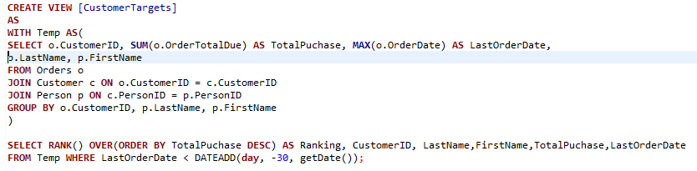

Customer Targets

Slide 15
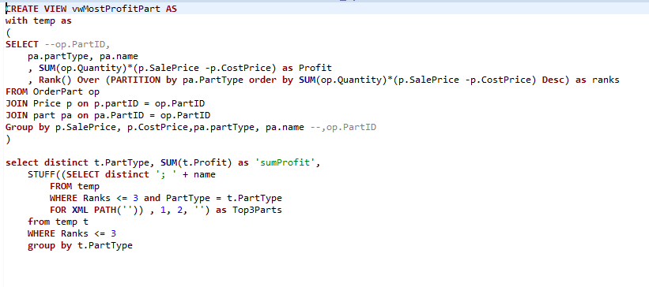
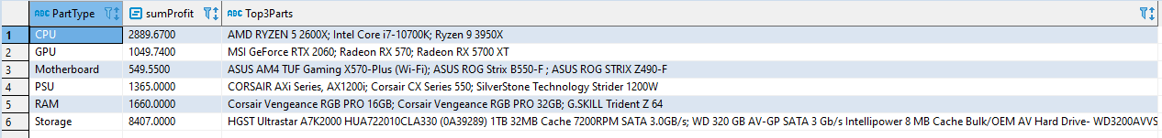
Most Profitable Part

Slide 16
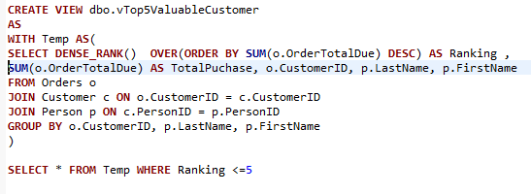
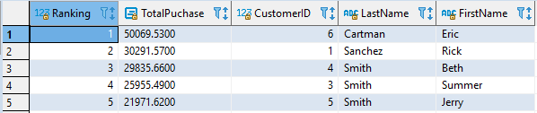
Most Profit Generating Customers

Slide 17
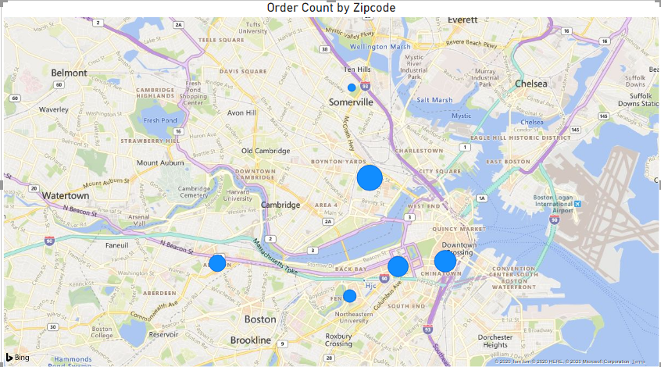
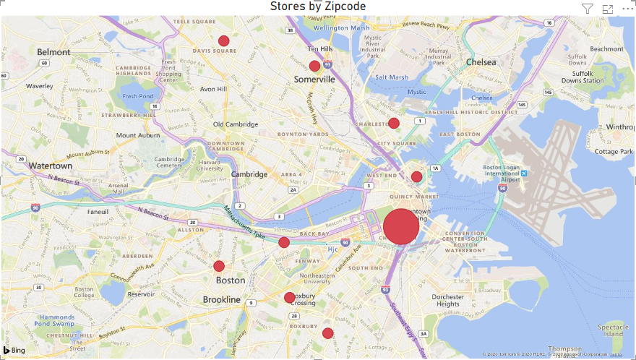
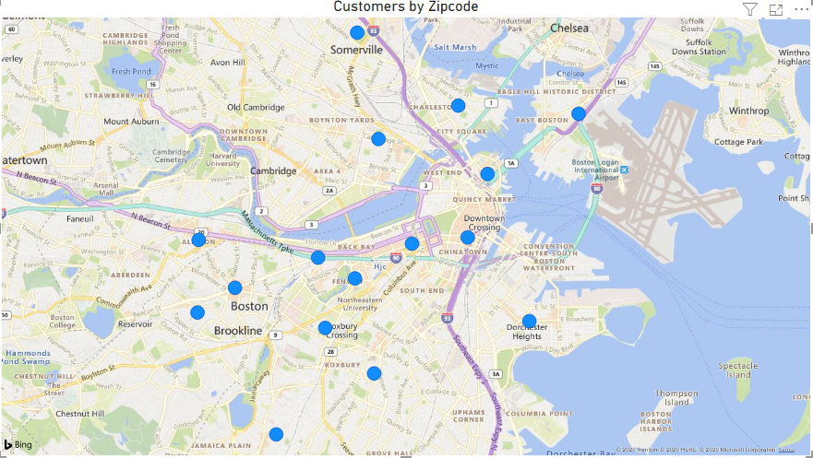

Slide 18
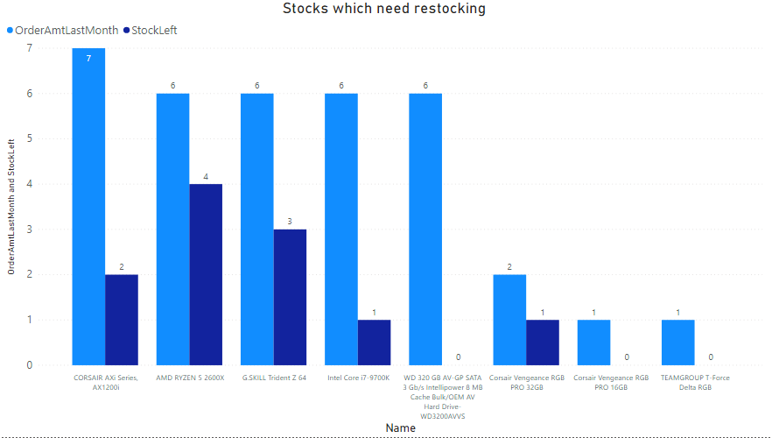
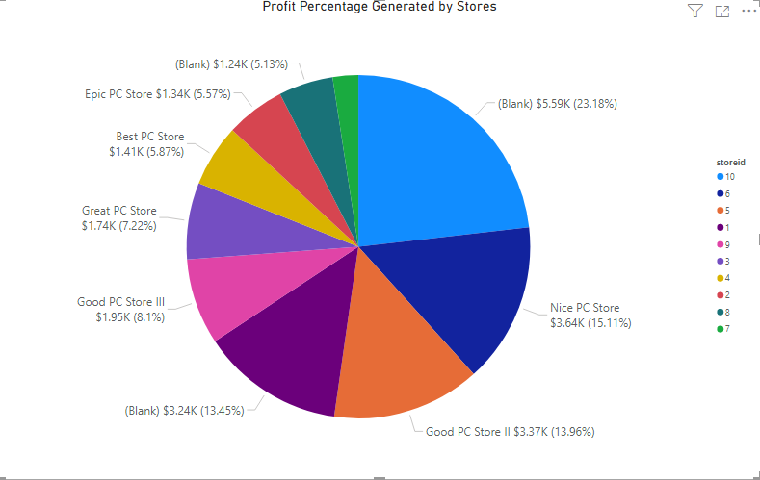

Slide 19
Q & A
z

